Slide 1
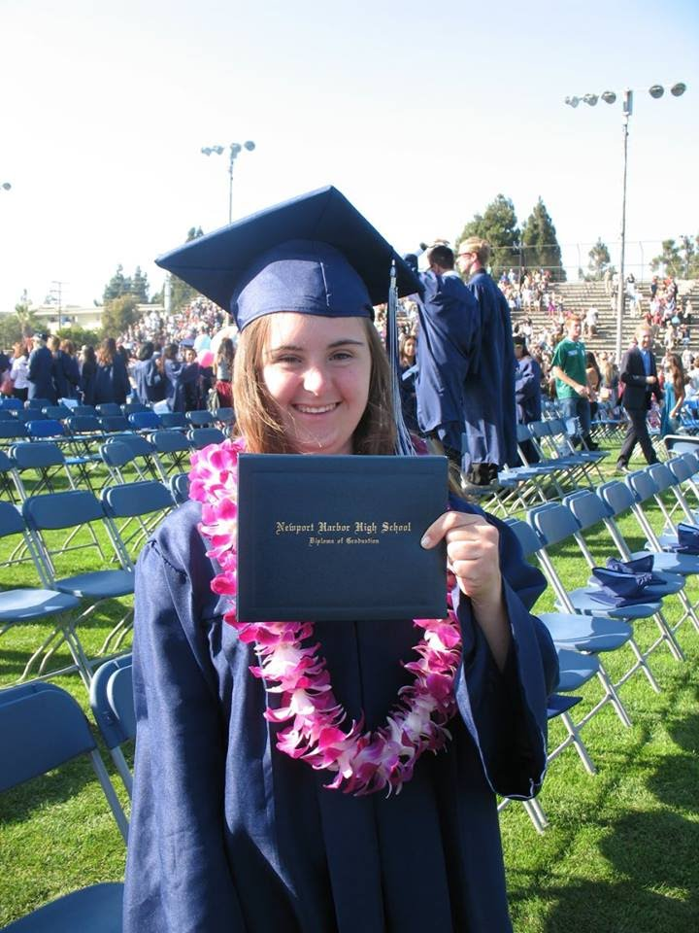
My Awesome Life
By Shanel Ames

Slide 2
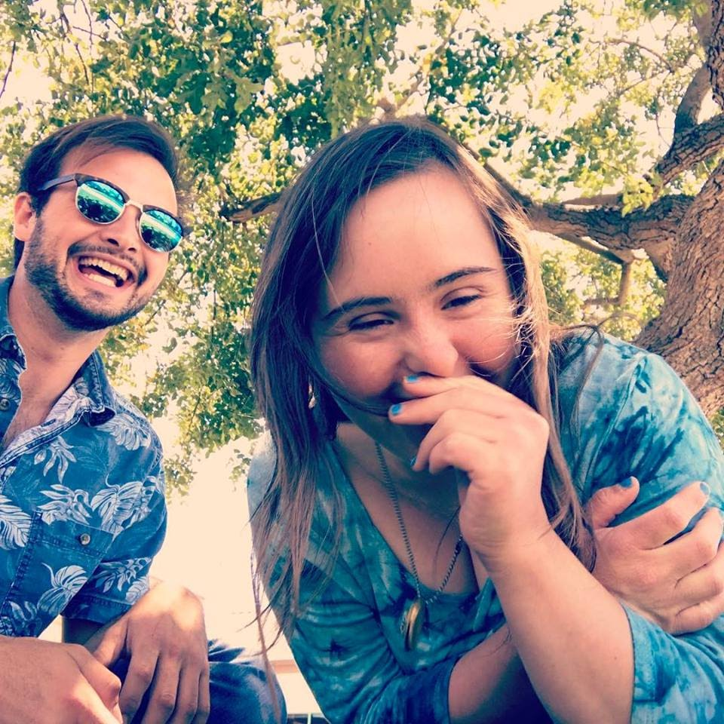
Living with Down Syndrome
Sometimes I have a lot of ups and downs but mostly
positive ups. Living with Down syndrome has taught
me patience, team work, about being a good friend to
everyone, and also to have positive attitude.
In my experience my family and friends are very important to me because they are supportive and help make my dreams and goals come true. Having Down syndrome makes me feel happy, special and proud of being myself.

Slide 3
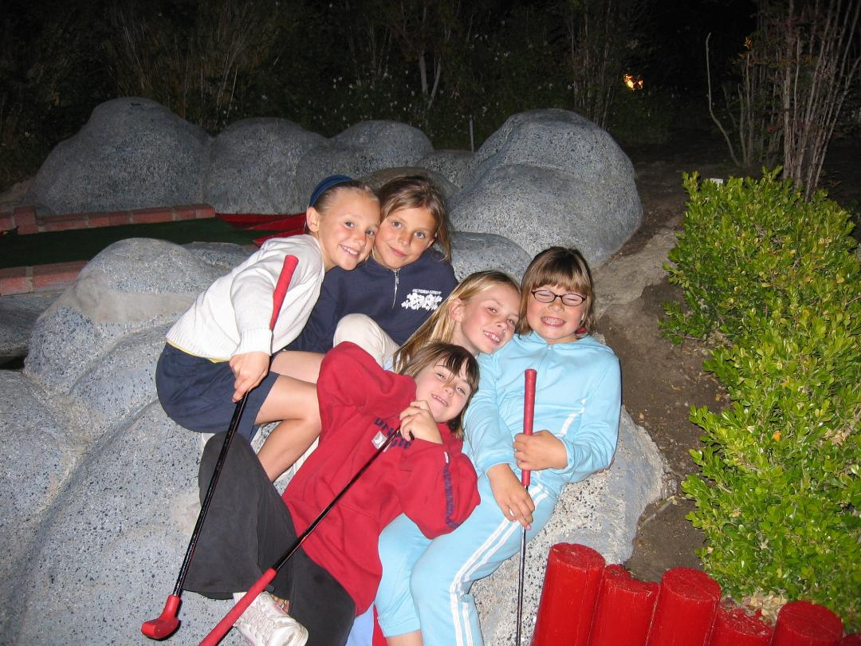
Elementary Years
Early on I grew up to learn more about myself
and my family’s Irish culture. I learned to love myself
and my extra chromosome.
When I was younger I was always shy but learned to open up more in situations and become more comfortable in unfamiliar environments. I attended Victoria Elementary where I made many friends including my best friend Dylan. I was included in the general education classes. I participated in lots of activities outside of school also like Indian Maiden (YMCA) group.
Sometimes I would get mixed feelings but always kept a positive attitude. My friends would also agree I always smiled through. At a young age I felt included and that I fit wherever I went, both in public and private places.

Slide 4
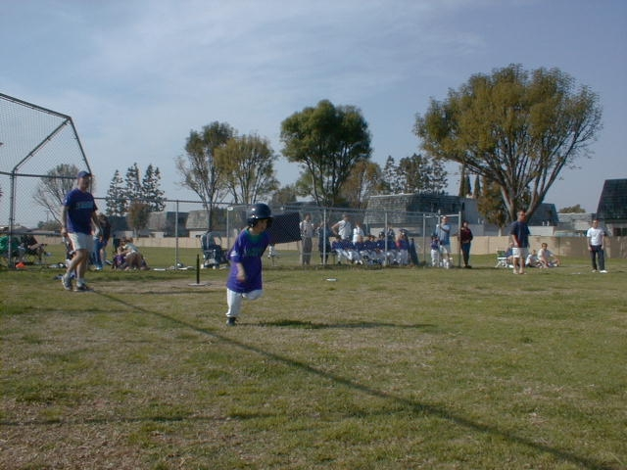
Elementary Years
I participated in sports like soccer, T-ball/softball and gymnastics in our City programs.
I was part of the school plays and even participated in community theater for a few years.
Being a part of these groups helped me with my shyness and get to know new people.

Slide 5
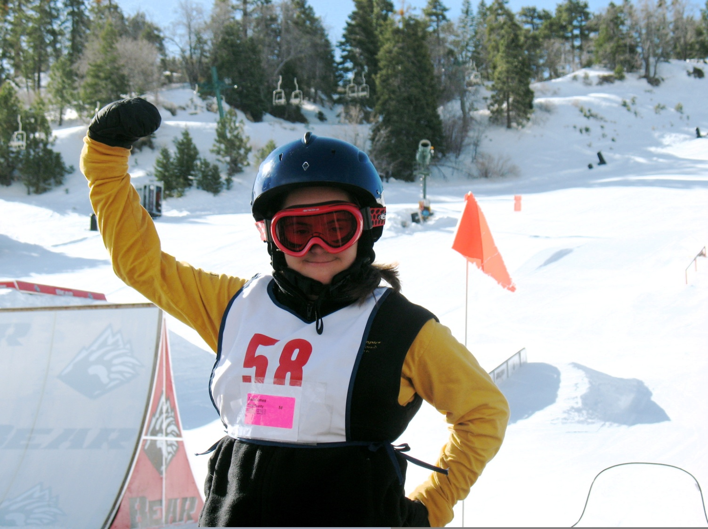
Other Activities
I participated in a lot of activities for people with disabilities as well, like skiing and gymnastics.
I felt very accomplished on the ski team - I was the coach’s secret weapon and always received a medal.
Being in these programs allowed me to stay
active and meet all kinds of people living
with and without disabilities.

Slide 6
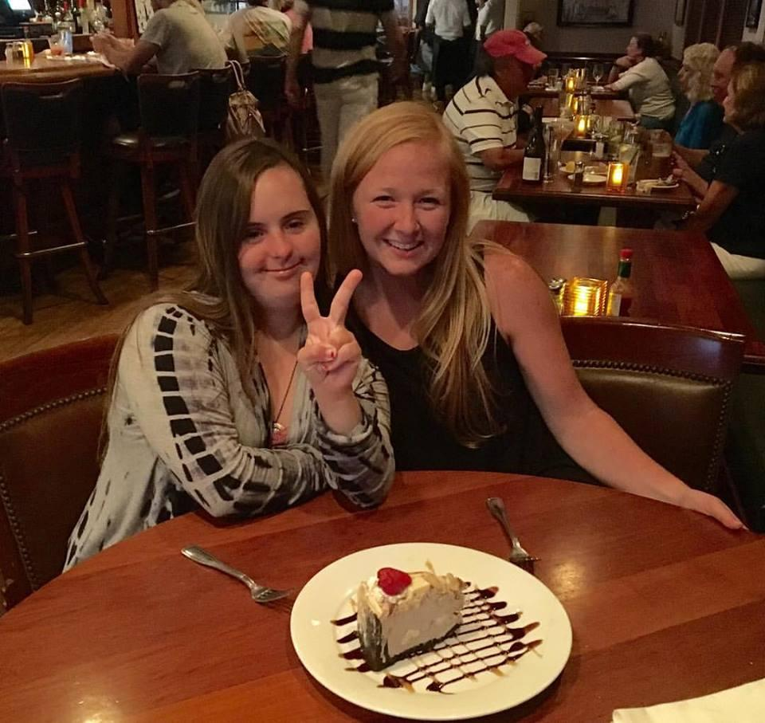
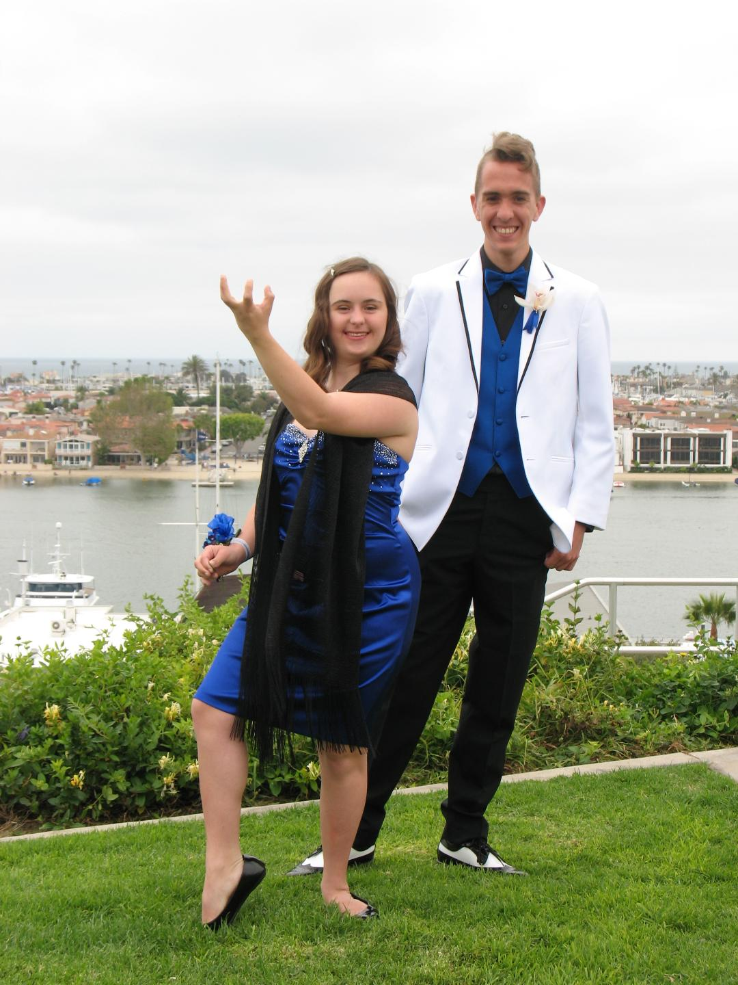
Newport Harbor High School
Through grade school I found I had a love for learning and that continued to high school.
I was nervous to start as the only person living with Down syndrome at school, but my coordinator introduced me as a “Newport Harbor High Student” not a special needs student and I got to continue in the general education classes.
I felt very comfortable and included, and learned a lot of important things about life that I would not have if I was not in general education classes.

Slide 7
Newport Harbor High School
I joined clubs such as Young Life, Federation for Christian Athletes and ones helping animals and people in different countries.
The best thing I did was to join the dance program. I danced all four years and even got to do a solo for over 350 people my senior year!
Getting involved in school groups was an opportunity to learn more new stuff and to hang out with friends outside of the school day.
I became the first student with Down syndrome to receive a high school diploma in the Newport Mesa School District!!

Slide 8
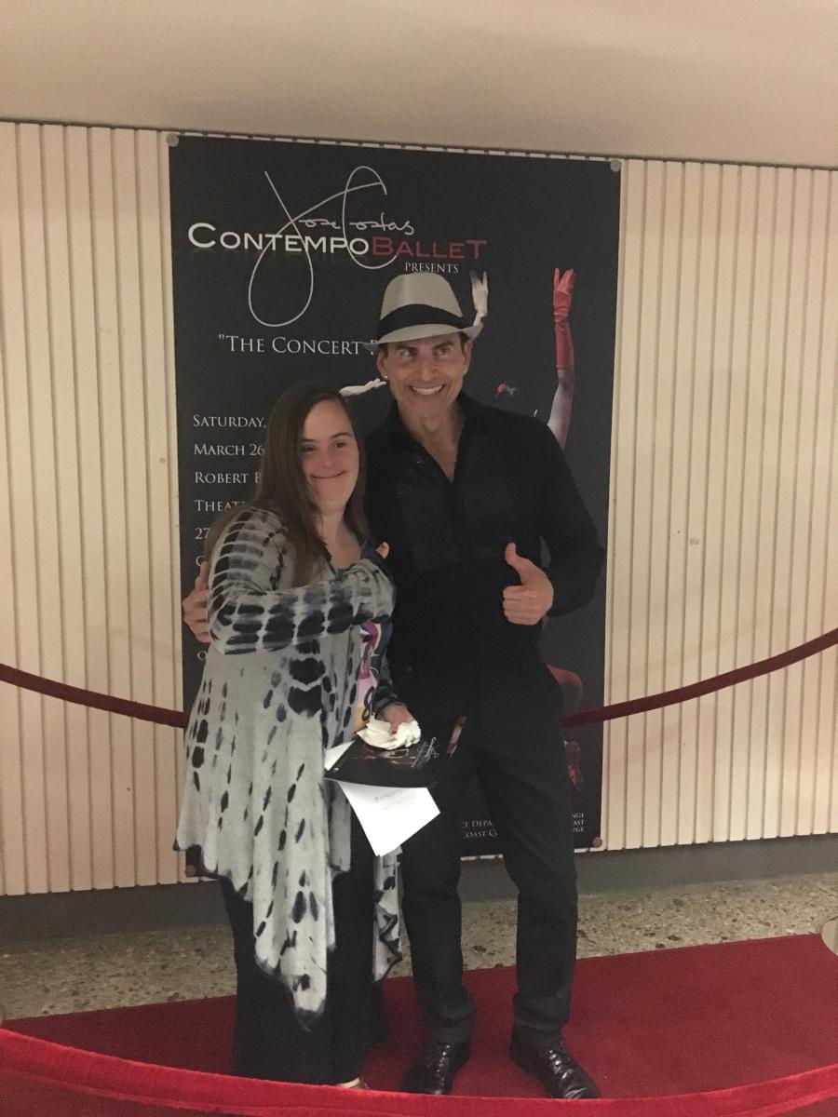
Today
I am currently attending my first semester at Coastline Community College taking a culinary and an employability class. Cooking is a passion of mine so taking this class will give me a chance to learn more.
I’ve also been a student at Orange Coast College for over 7 years. I love to learn new things in the classes that I take. I’ve taken many courses such as computer skills, typing, ethics, history of rock and roll as well as jazz, mysticism and meditation class.
Each semester I also take a dance class. I have take tap, modern/lyrical, jazz, middle eastern, Latin, hip hop and ballet. I also have started taken choreography classes and am creating my own dances now.

Slide 9
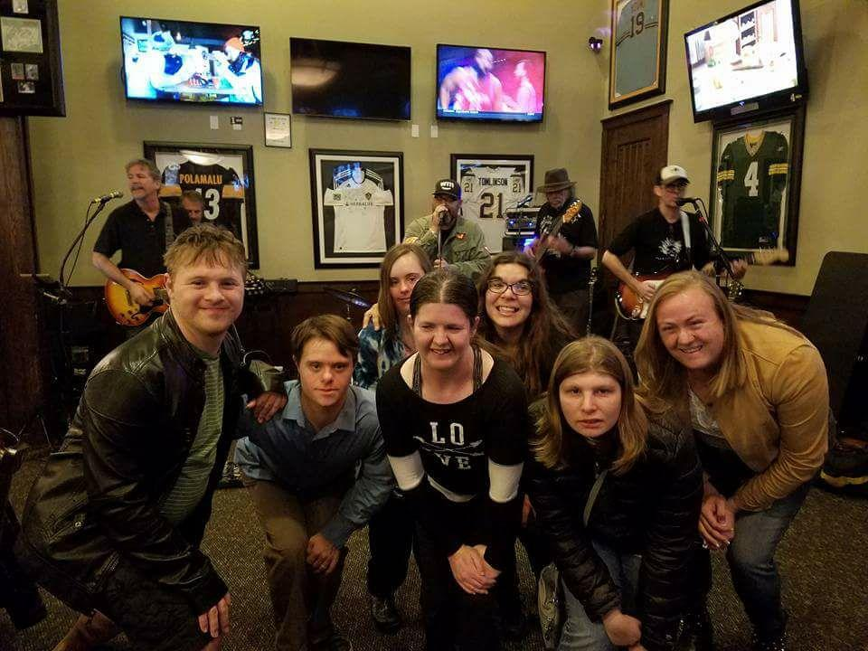
Today
I enjoy taking many classes that interest me. I have always focused on learning and staying active academically. I like to do homework and keep myself busy with reading. Sometimes I don’t pass a class but I enjoy learning and even though I might not get it all, I learn something every time.
I have a great support system and I have a lot of friends with and without Down syndrome that I can trust to help me be the best I can be.

Slide 10
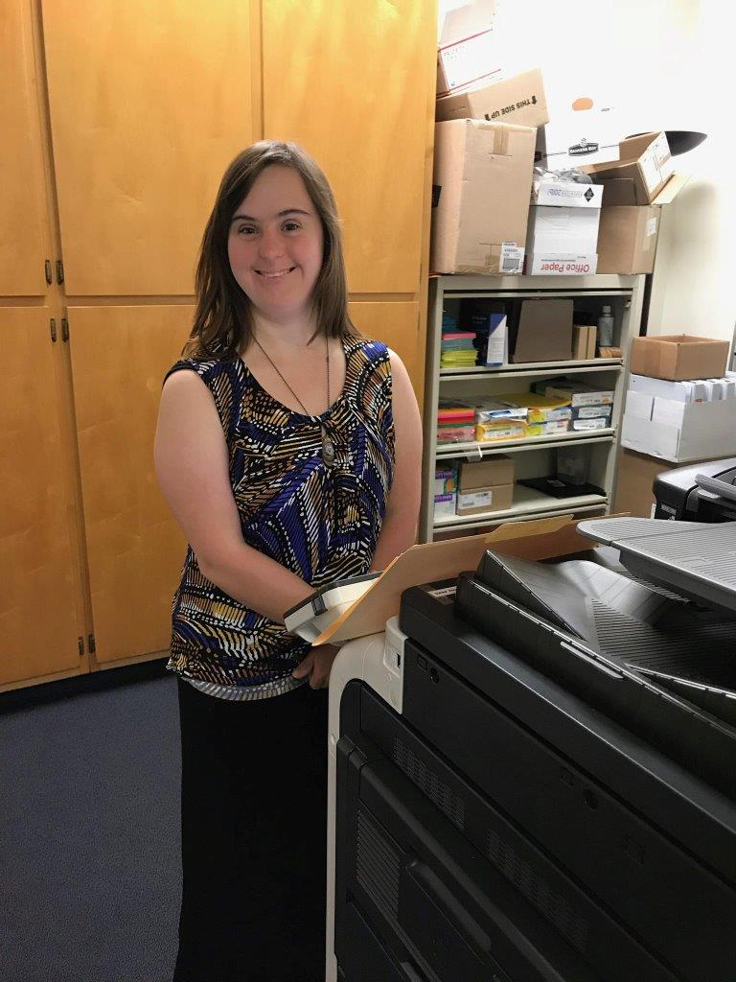
Today
I am currently in an employment program named IRI. I have 3 job coaches that help and teach me with skills that are required for my job.
I go to church at Saint Michaels . I have been an active member there for many years.
I continue to have a very active social life. I have a lot of friends with and without disabilities. One of my favorite activities to do with my friends is go out to the movies and just hang out.

Slide 11
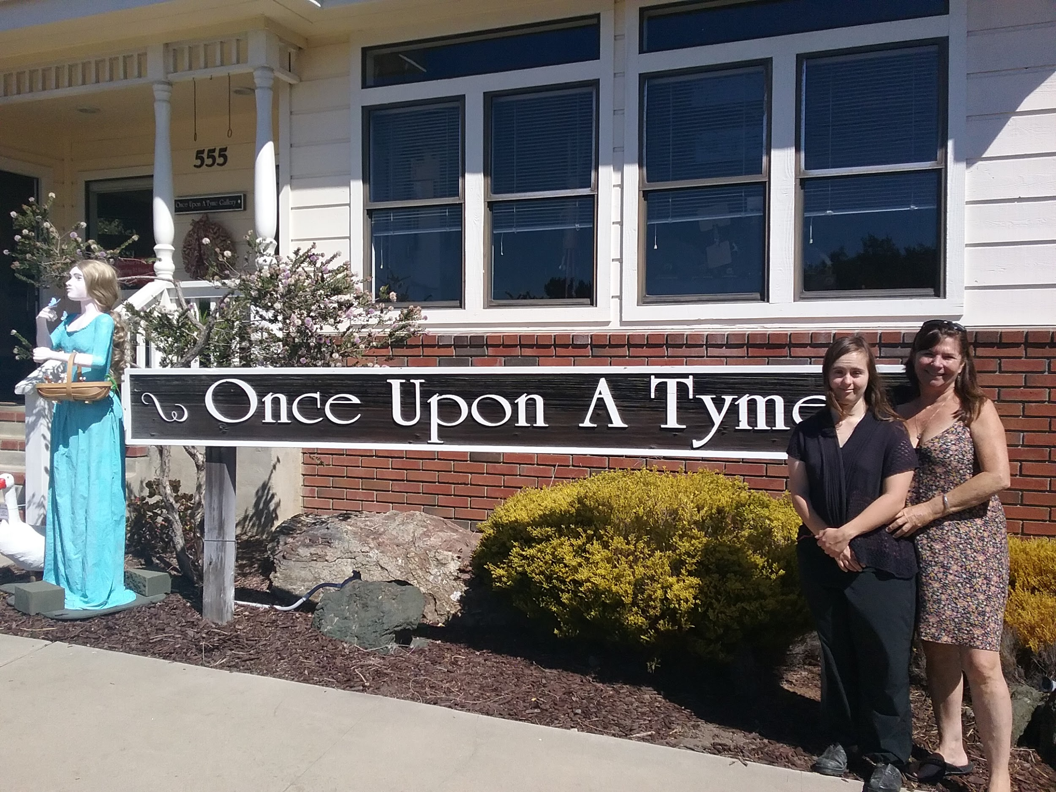
My Future
In my future I see myself becoming an advocate like my mom and helping others with disabilities. I am currently the I CAN Coordinator and working towards making my dreams possible.
I am helping build teams that will work on person centered planning with individuals with disabilities, and am also helping adults with disabilities locate important resources.

Slide 12
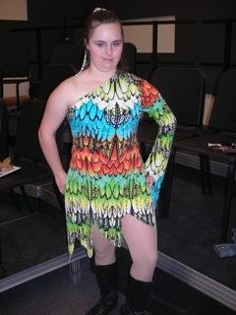
My Future
I have a passion for dancing. My dream is to become a choreographer.
Before Covid I had applied to work at the Segerstrom Dance Academy helping them with their administration and marketing tasks as well as assisting dance instructors with their students. This program is designed for dancers with disabilities. I hope to get to do this in the future.

Slide 13
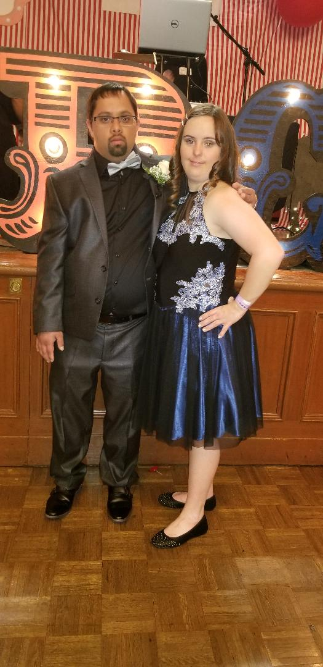
My Future
I am currently dating a nice guy named Parth. He is a gentleman to me. Our first date was right before Covid- 19. We went to a formal dance and had a great time.
We have not been able to go out on a date since but have had the chance to go on a picnic with our moms. We do get the chance to hang out online though which has been a good way to get to know him better
I am excited to see what our future holds for the both of us.

